Slide 1
Programming Fundamental Course
Chapter 16 – Understanding Data, Database and System

Slide 2
Reflection
What is IDE?
What kind of features are normally included in IDE?

Slide 3
Objectives
After this lesson, you should be able to understand
Data
Database
Simple Student Information System

Slide 4
What is Data?
Facts and statistics collected together for reference or analysis
The quantities, characters, or symbols on which operations are performed by a computer, being stored, retrieved and transmitted
The most important information in computer program
Program crash or lost → can re-write
Data lost → can’t retrieve

Slide 5
Program & Data
Student
Program
Student
Data
Report
Program
Other
Program…

Slide 6
Student Information System
1 : Add Student
2 : Print All Students
3 : Exit
Select Number( 1 or 2 or 3) : 1
Enter Student No : S00001
Enter Student Name : Aung Aung
Saving Successful.
1 : Add Student
2 : Print All Students
3 : Exit
Select Number( 1 or 2 or 3) : 2
Student No Student Name
S000001 Aung Aung
1 : Add Student
2 : Print All Students
3 : Exit
Select Number( 1 or 2 or 3) : 3
Bye!!!

Slide 7
Student Information System Development
File -> New -> Java Project -> StudentInformationSystem
Right click on project -> New -> Class ->StudentMenu
Right click on project -> New -> Class -> Student

Slide 8
Student Information System
Student.java
- StudentNo
- StudentName
- SaveStudentInformation()
- PrintStudentInformation()
StudentMenu.java
- ShowMenu
1 : Add Student
2 : Print Student Information
3 : Exit
Your Selection :
- Accept Selection
- Do process
Save or Print

Slide 9
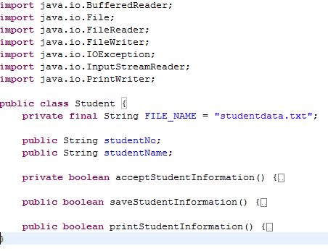
Student.java

Slide 10
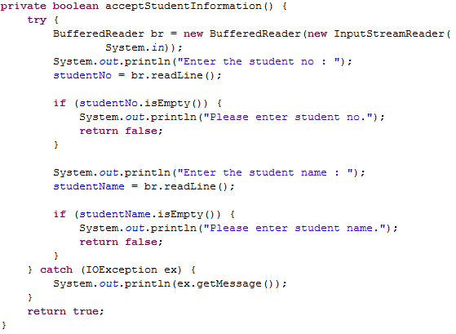
Student.java

Slide 11
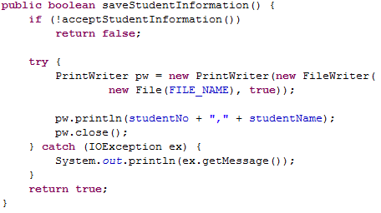
Student.java

Slide 12
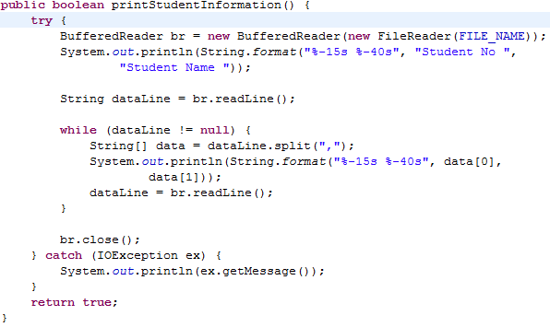
Student.java

Slide 13
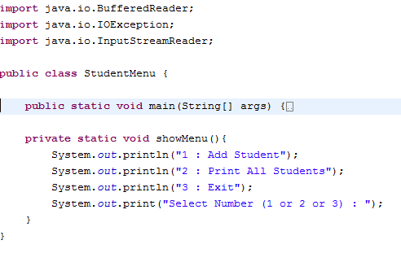
StudentMenu.java

Slide 14
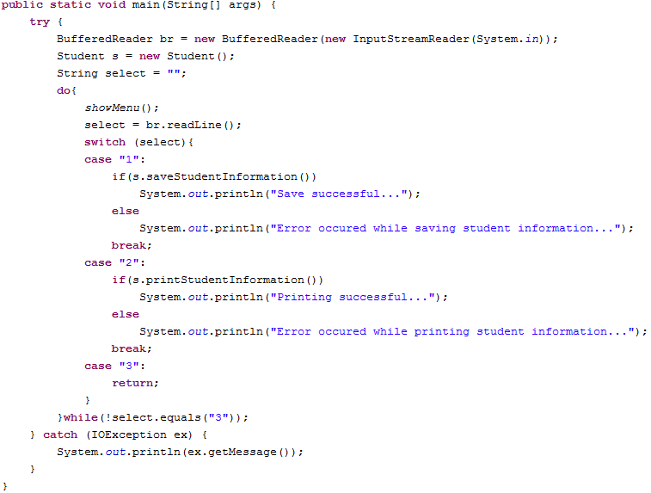
StudentMenu.java

Slide 15
So what are the benefits of saving data externally?
Data are still available even after program close
Multiple program can access the data simultaneously
Adding student and printing can be done at the same time by 2 different person

Slide 16
DBMS
Database Management System
A special program which provide systematic way to create, retrieve, update and manage data.
Additional features
Security ( Authentication and Authorization)
Transaction & Concurrency
Backup & Restore
Performance

Slide 17
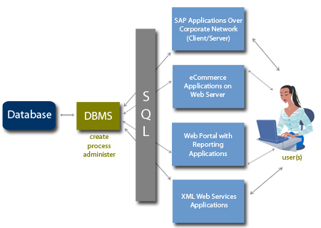
DBMS & SQL
SQL = Structure Query Language

